Slide 2
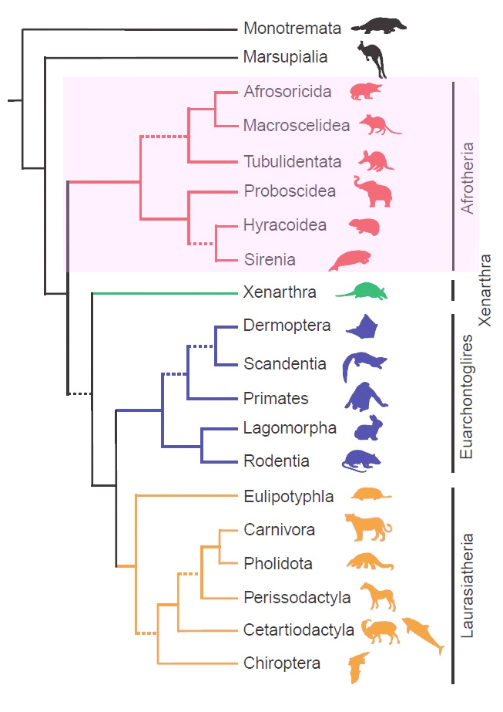
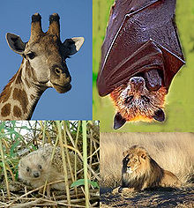
Laurasiatheria

Slide 3
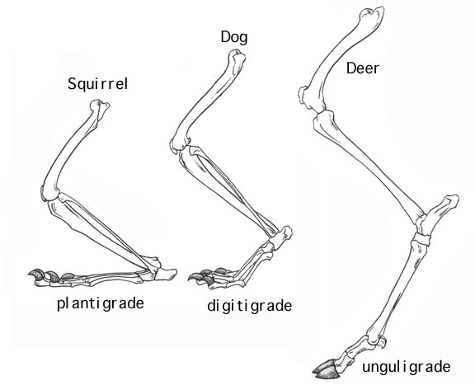
Laurasiatheria
Ferae

Slide 4
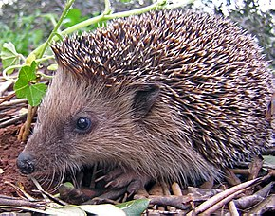
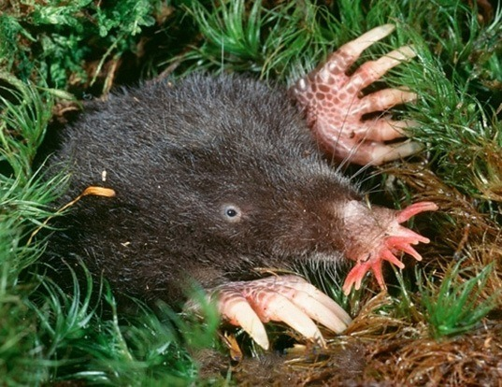
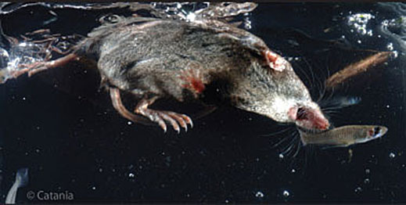
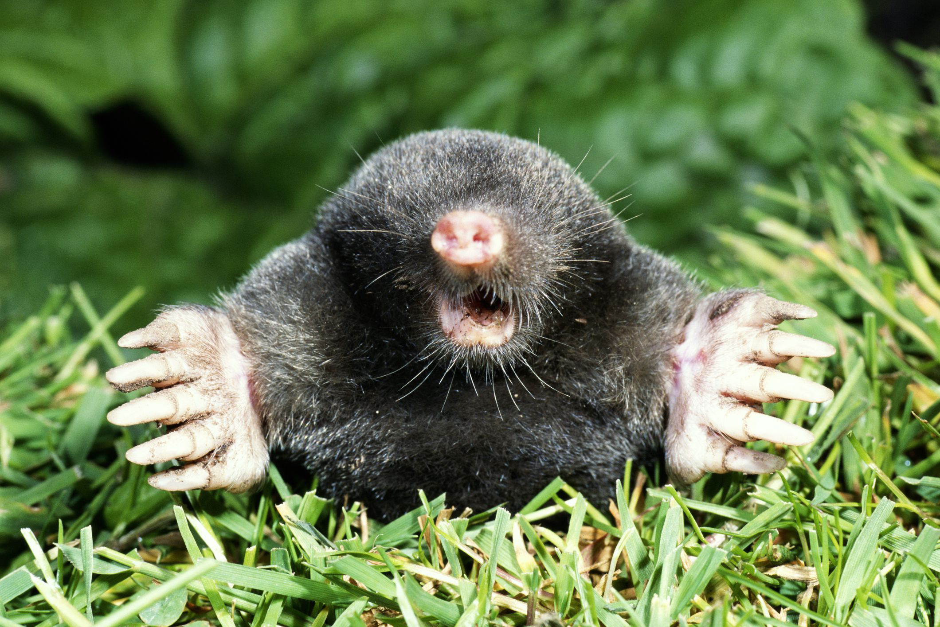
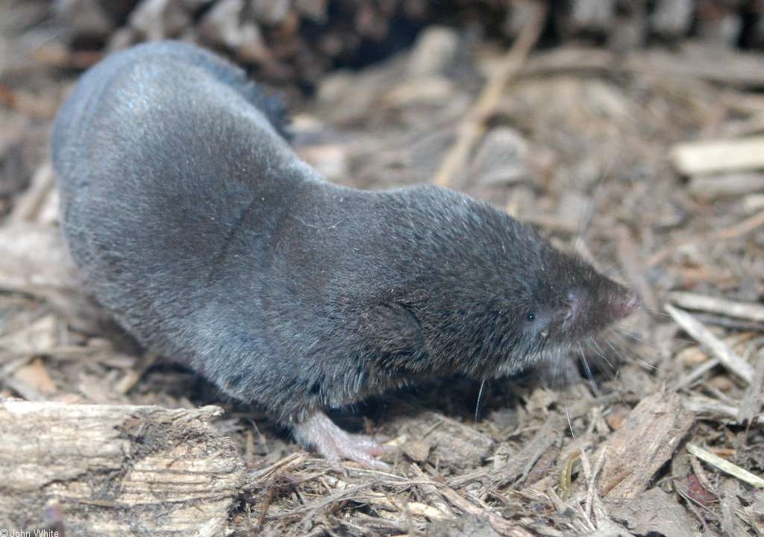
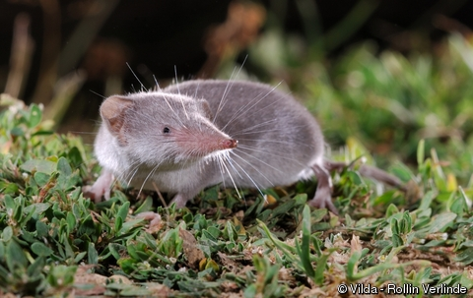
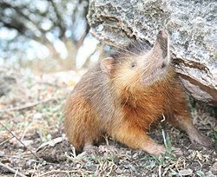
Euliptophyla (~350 species)
Notes:
https://s3.amazonaws.com/vu-wp0/wp-content/uploads/sites/182/2012/10/snm-movie-2.mp4

Slide 5
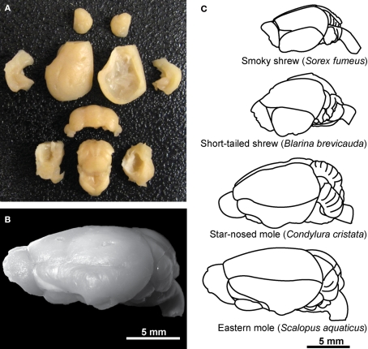
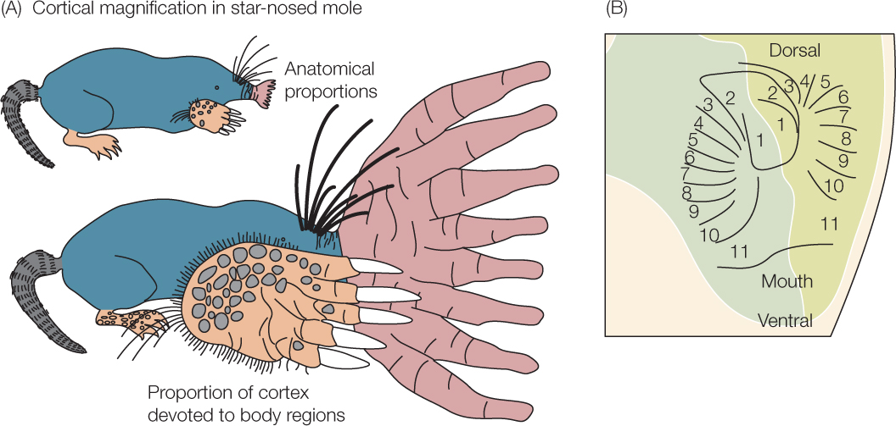
Euliptophyla
Talpidae
Sorcidae
Hedgehogs

Slide 6
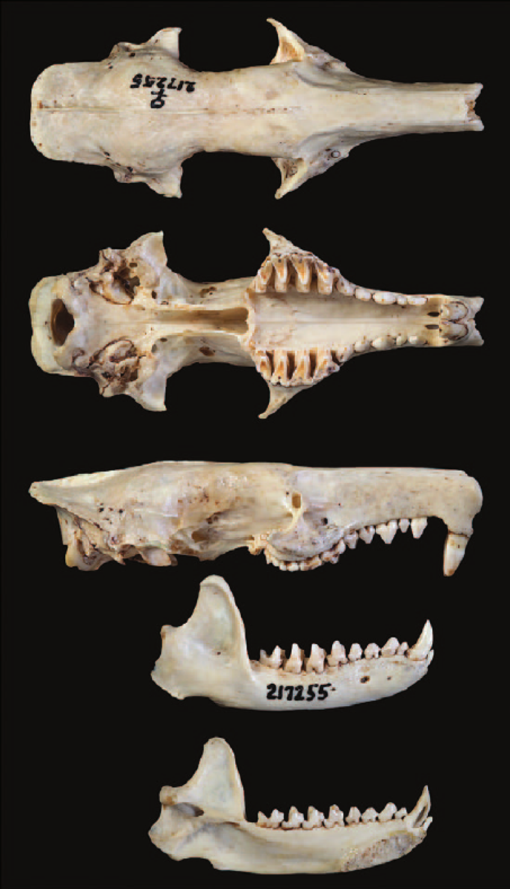
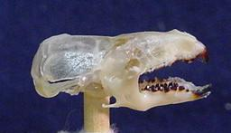
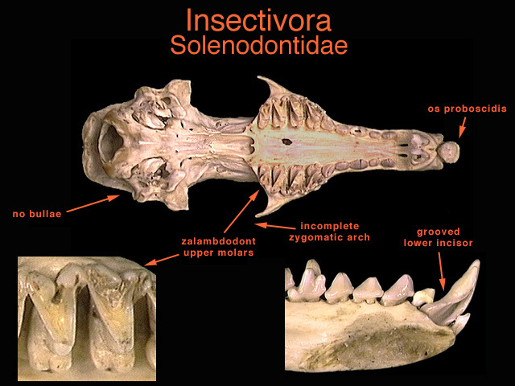
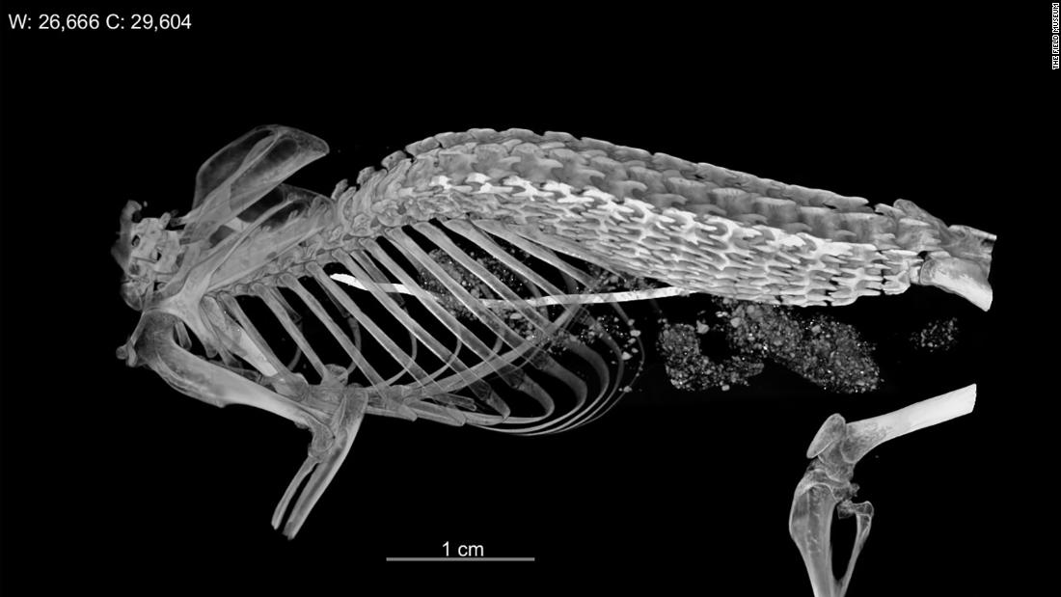
Euliptophyla

Slide 7
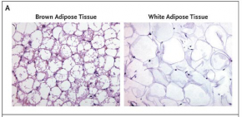
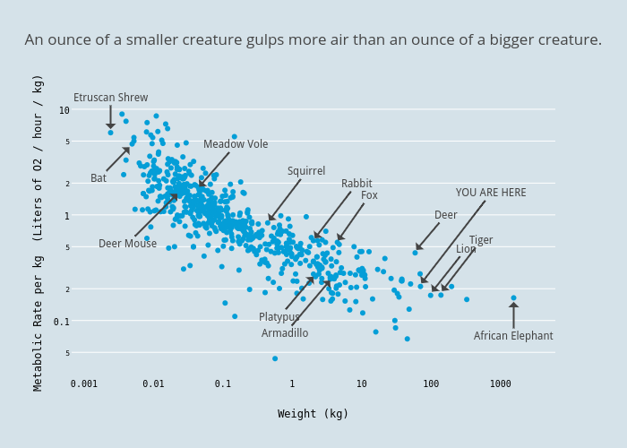
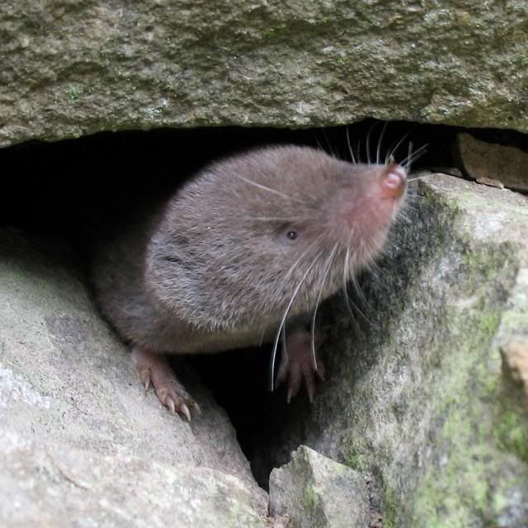
Euliptophyla
Notes:
Thyroid hormones control basal metabolic rate, esp Na/K pumps https://www.nature.com/articles/nm0910-965
Mention brown fat. https://www.ncbi.nlm.nih.gov/pmc/articles/PMC2375860/
T3 induces brown fat to burn (https://www.ncbi.nlm.nih.gov/pmc/articles/PMC4718641/)
Brown fat is loaded with mitochondria and controls thermogenesis
Endothermy evolution https://royalsocietypublishing.org/doi/10.1098/rstb.2019.0136

Slide 8
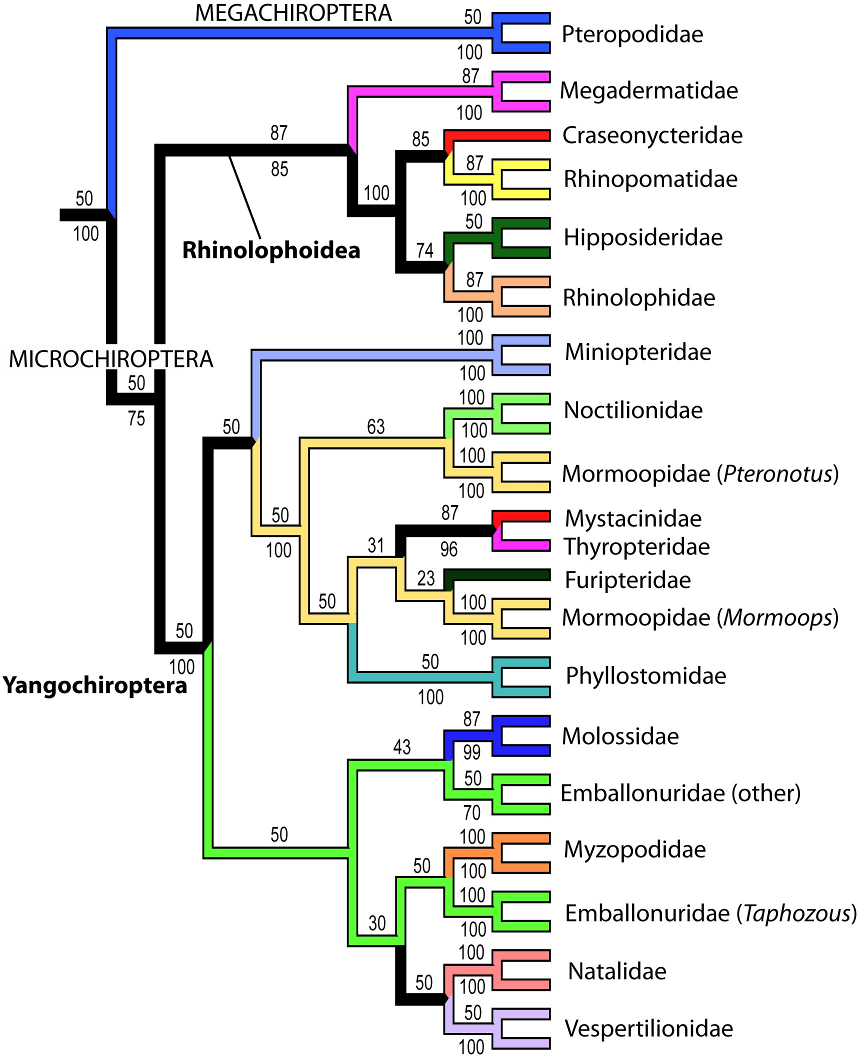
Chiroptera

Slide 9
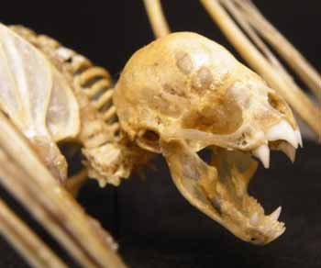
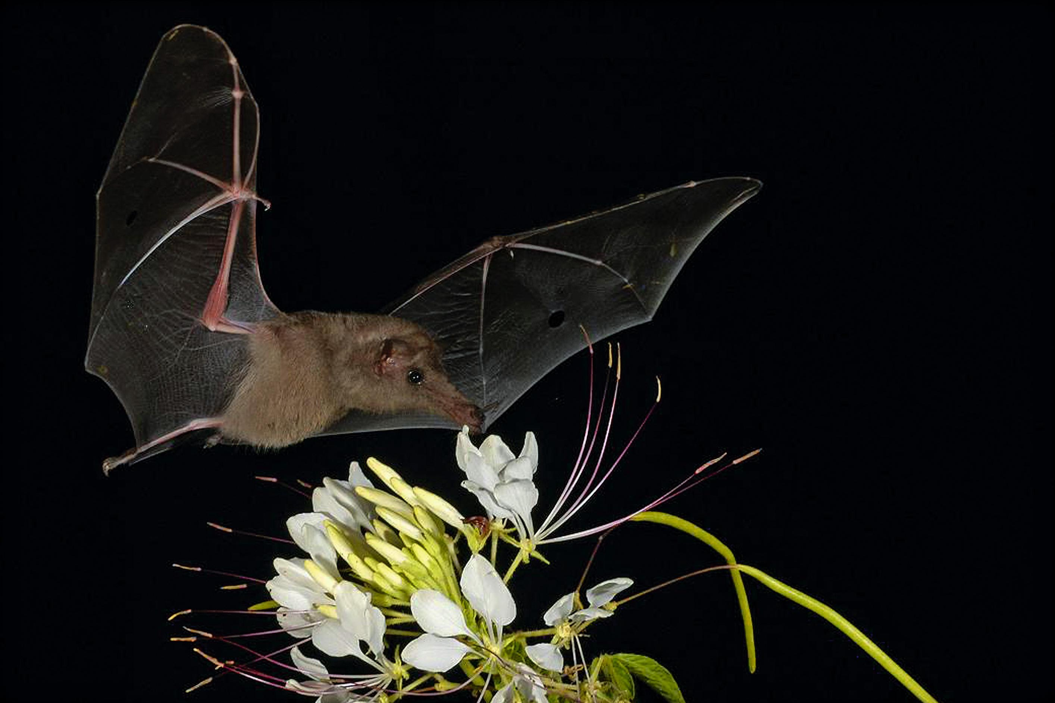
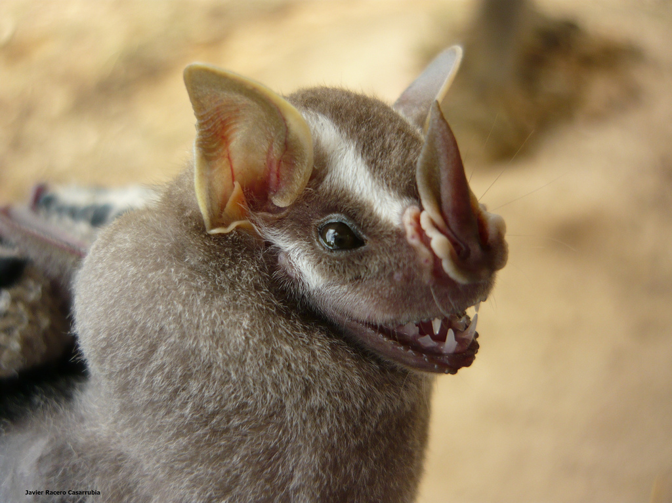
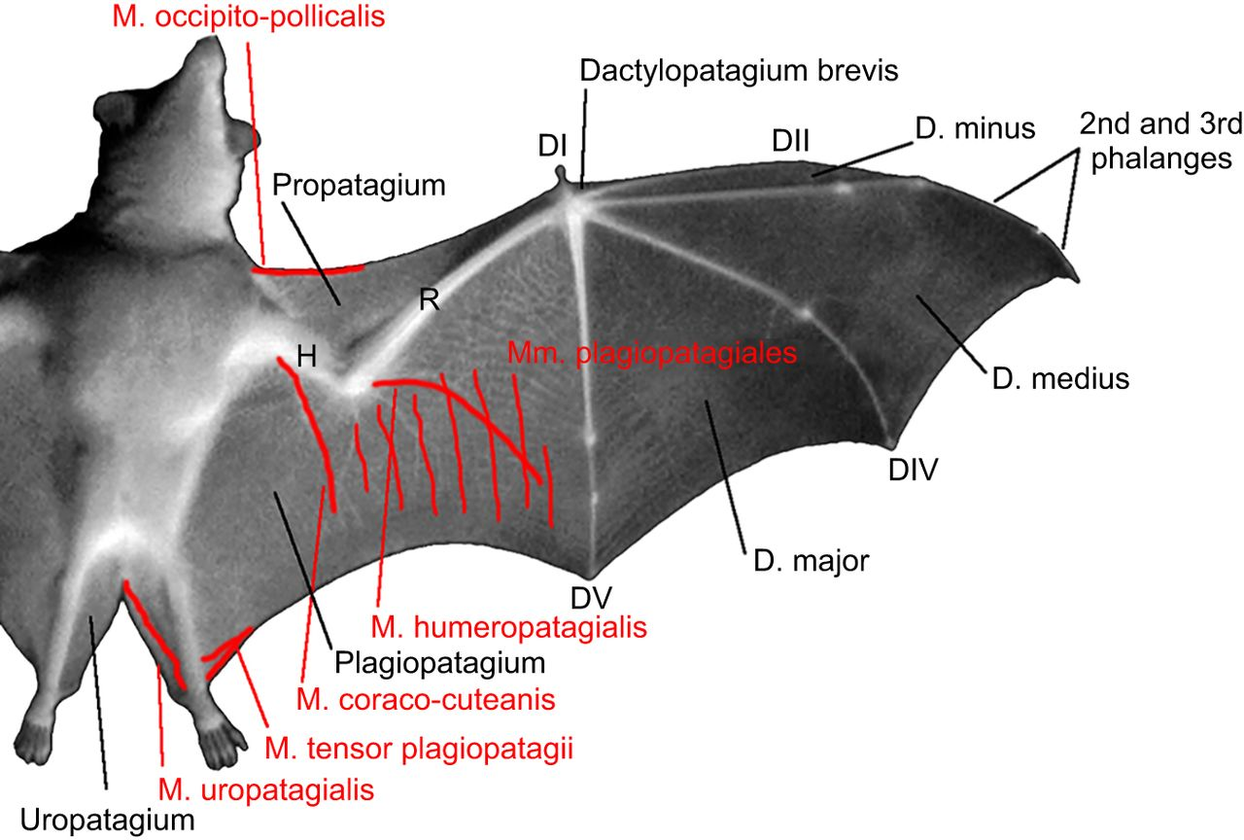
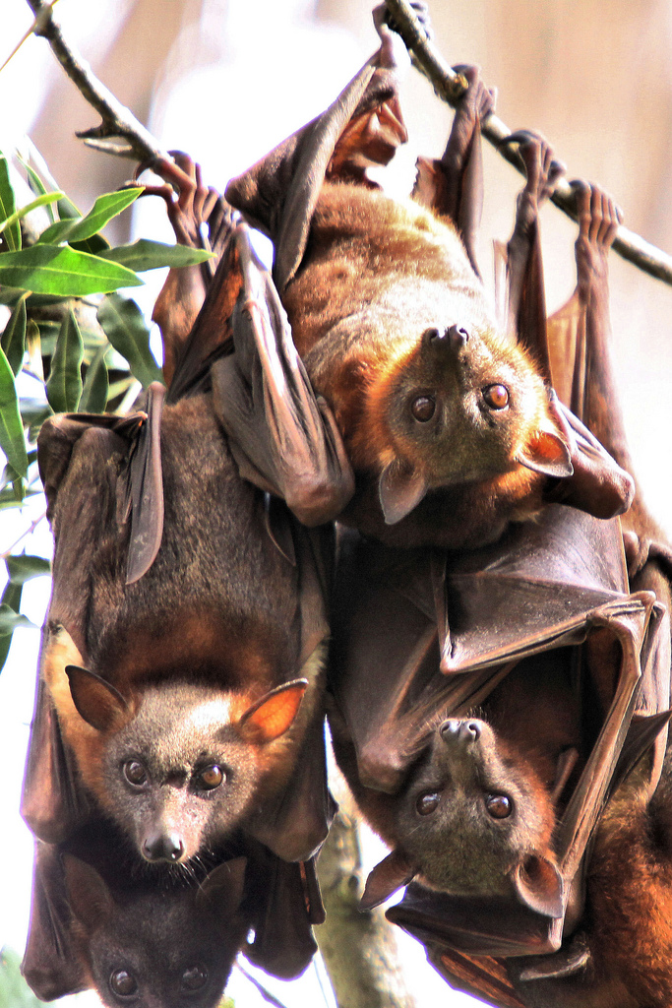
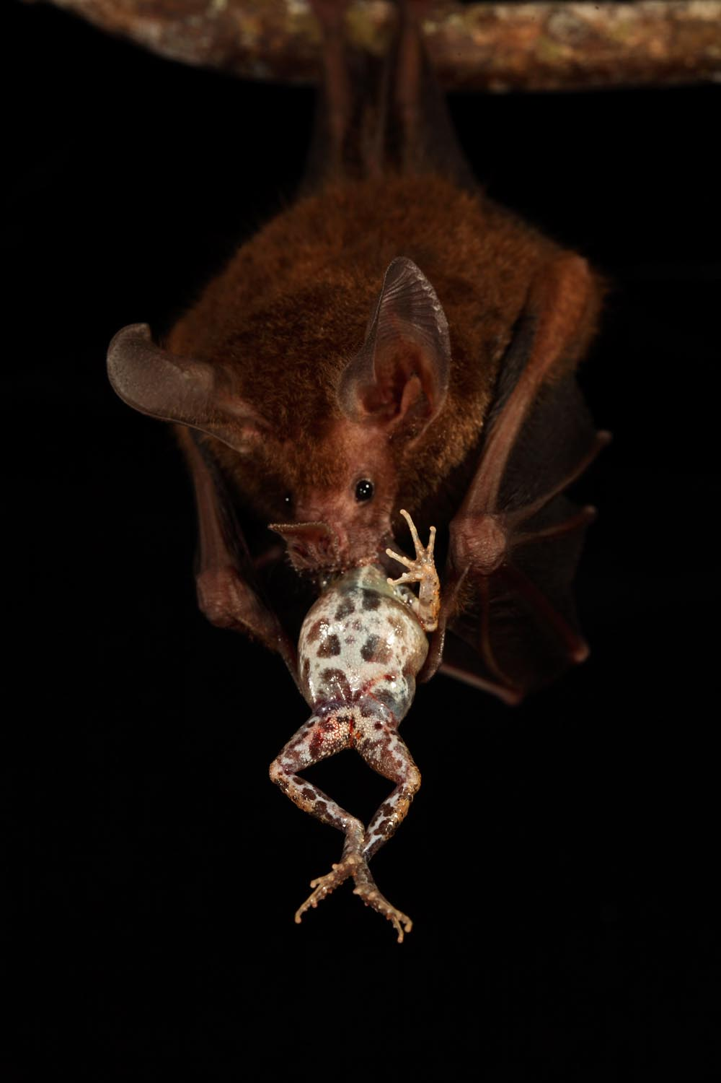
Chiroptera
Notes:
Bats have diverse ecology and they are the super maneuverable fliers. Count those joints! No flightlessness, only one ground-based bat.

Slide 10
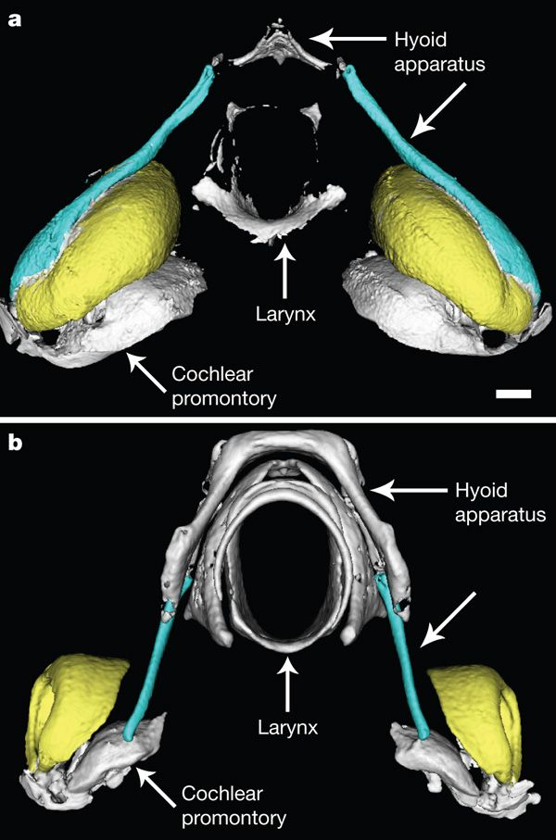
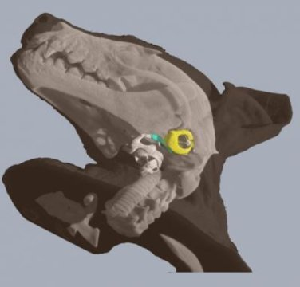
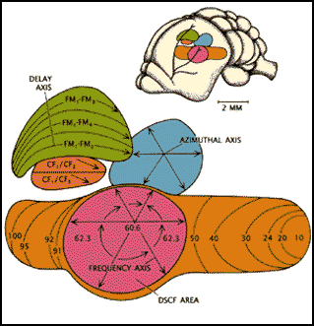
Chiroptera
Notes:
https://www.nature.com/articles/nature09219
https://pubmed.ncbi.nlm.nih.gov/20098413/
https://www.nature.com/articles/nature09156

Slide 11
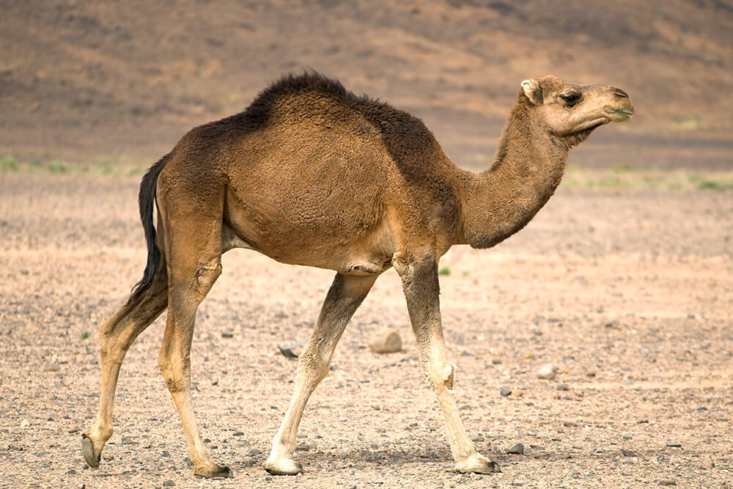
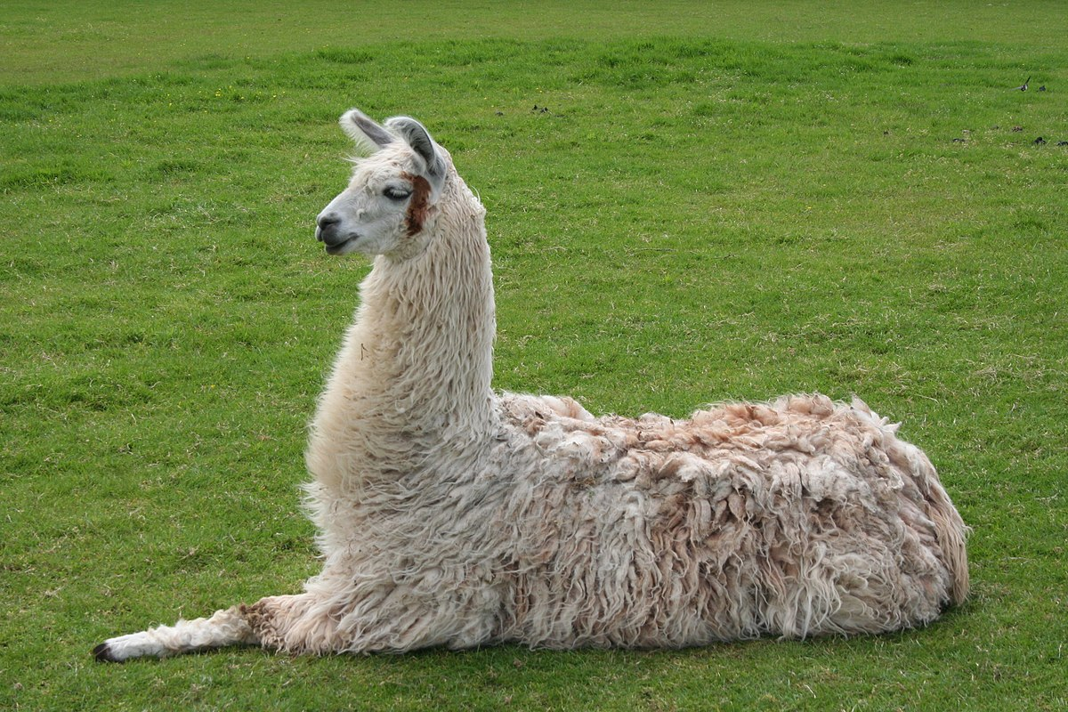
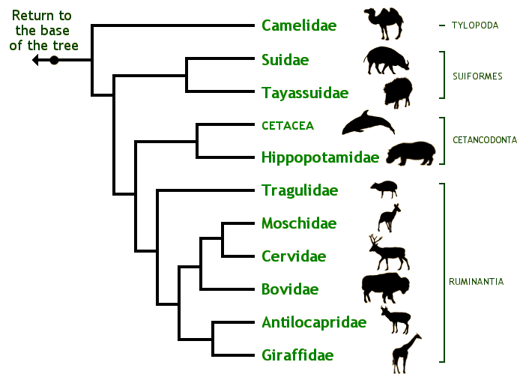
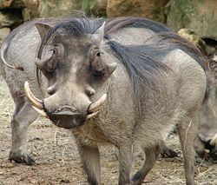
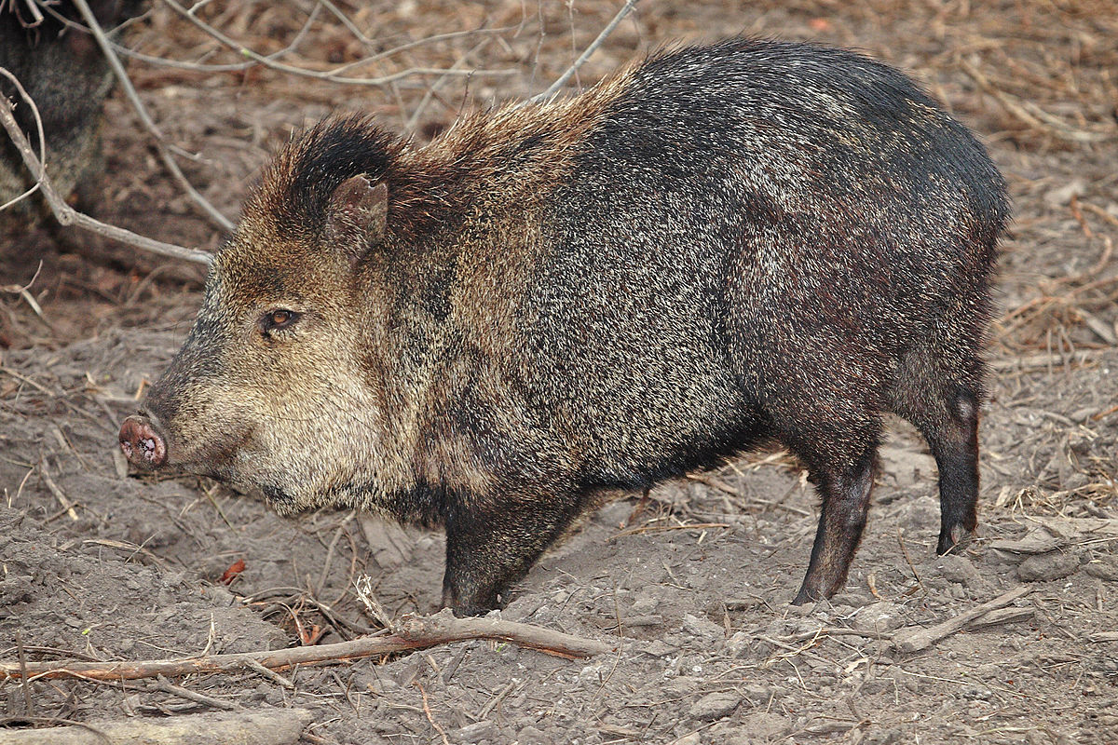
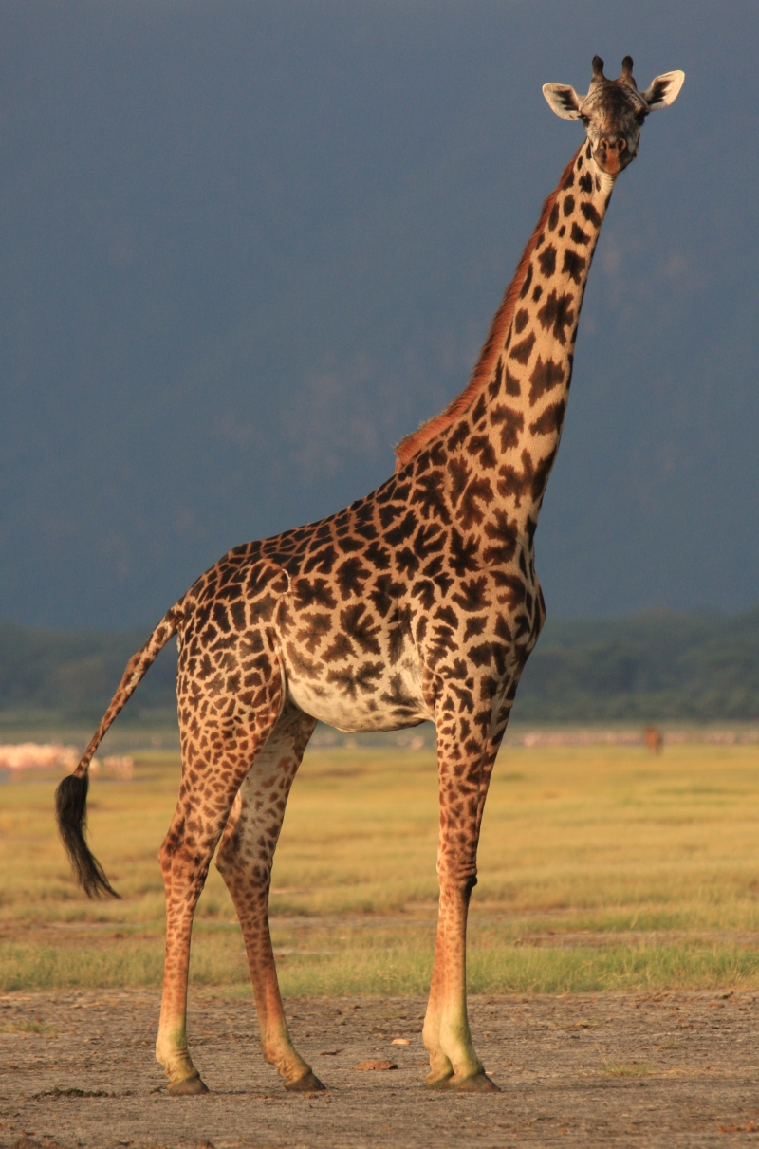
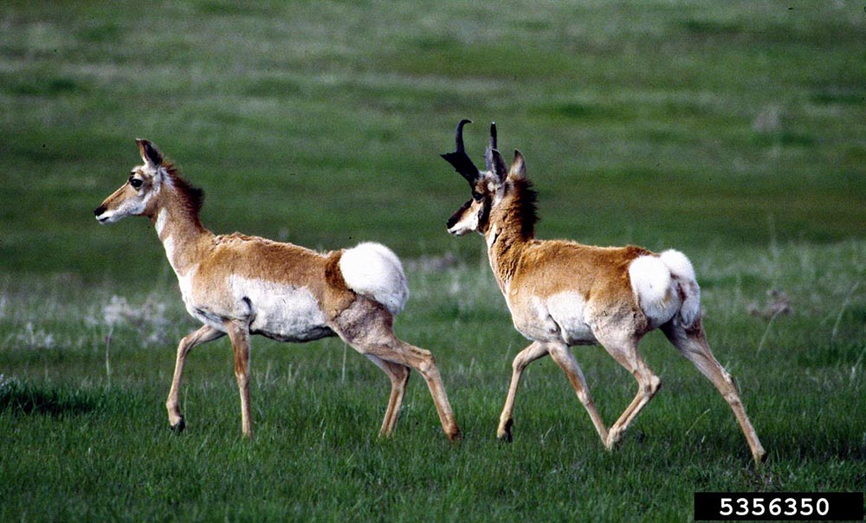
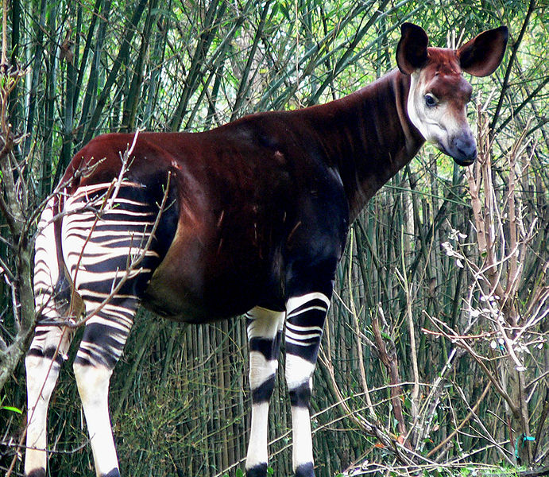
Cetartiodactyla

Slide 12
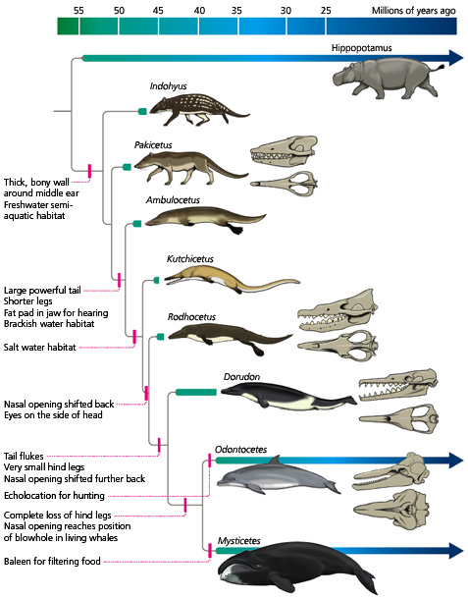
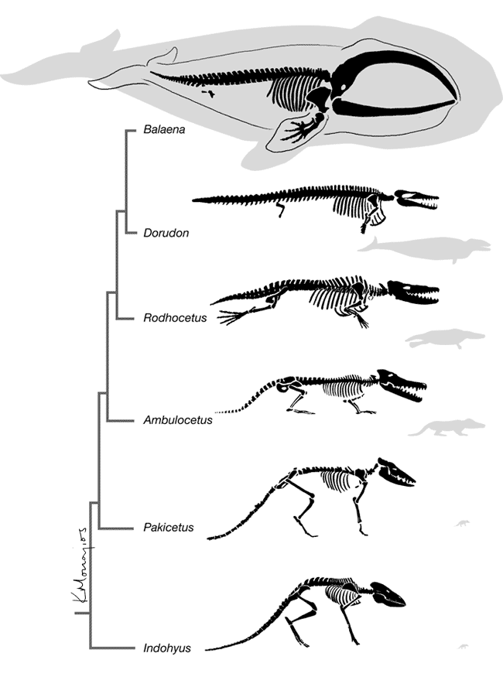
Cetartiodactyla

Slide 13
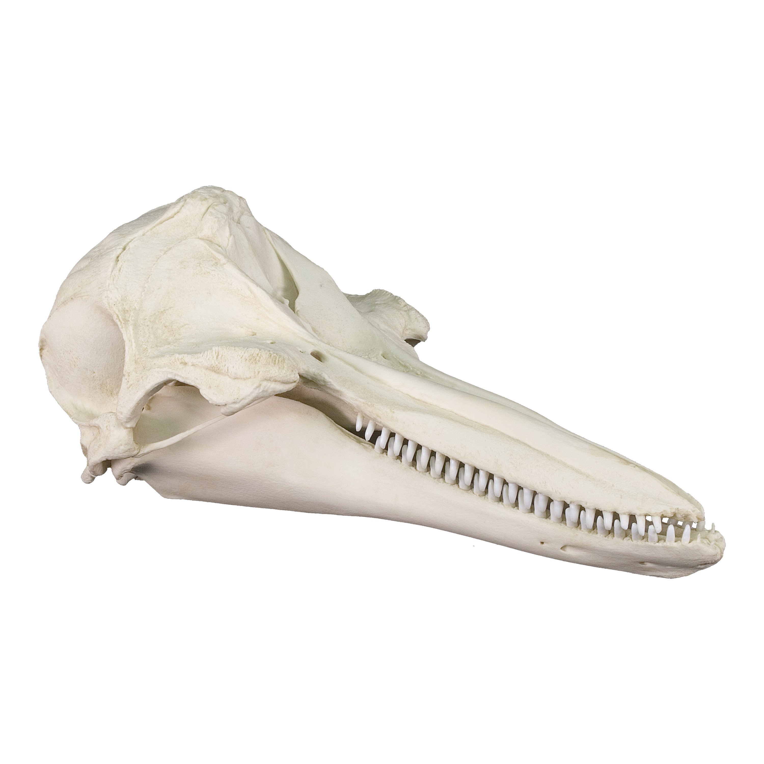
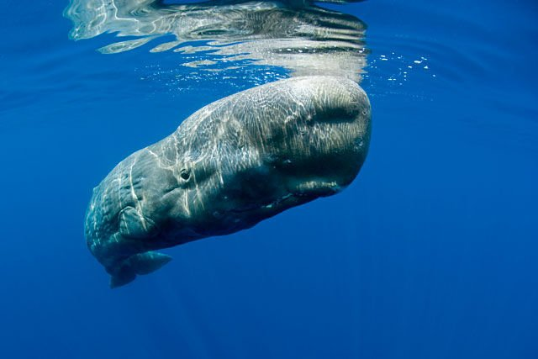
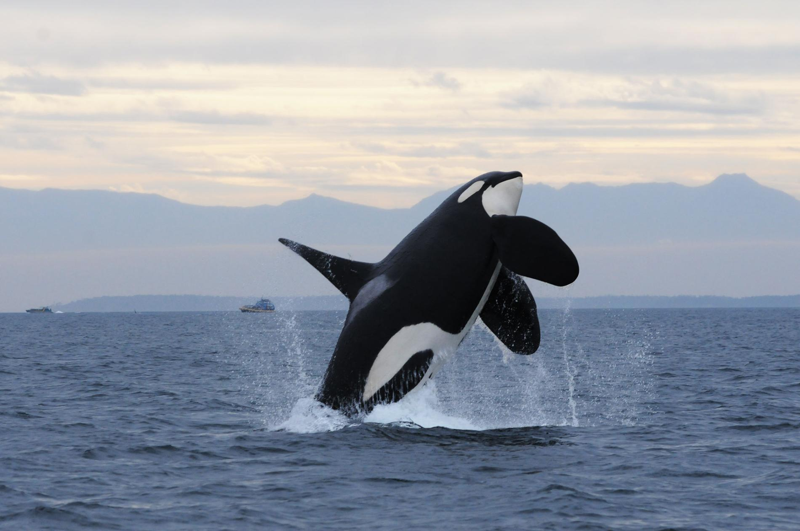
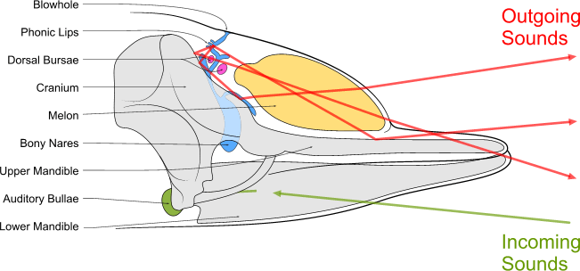
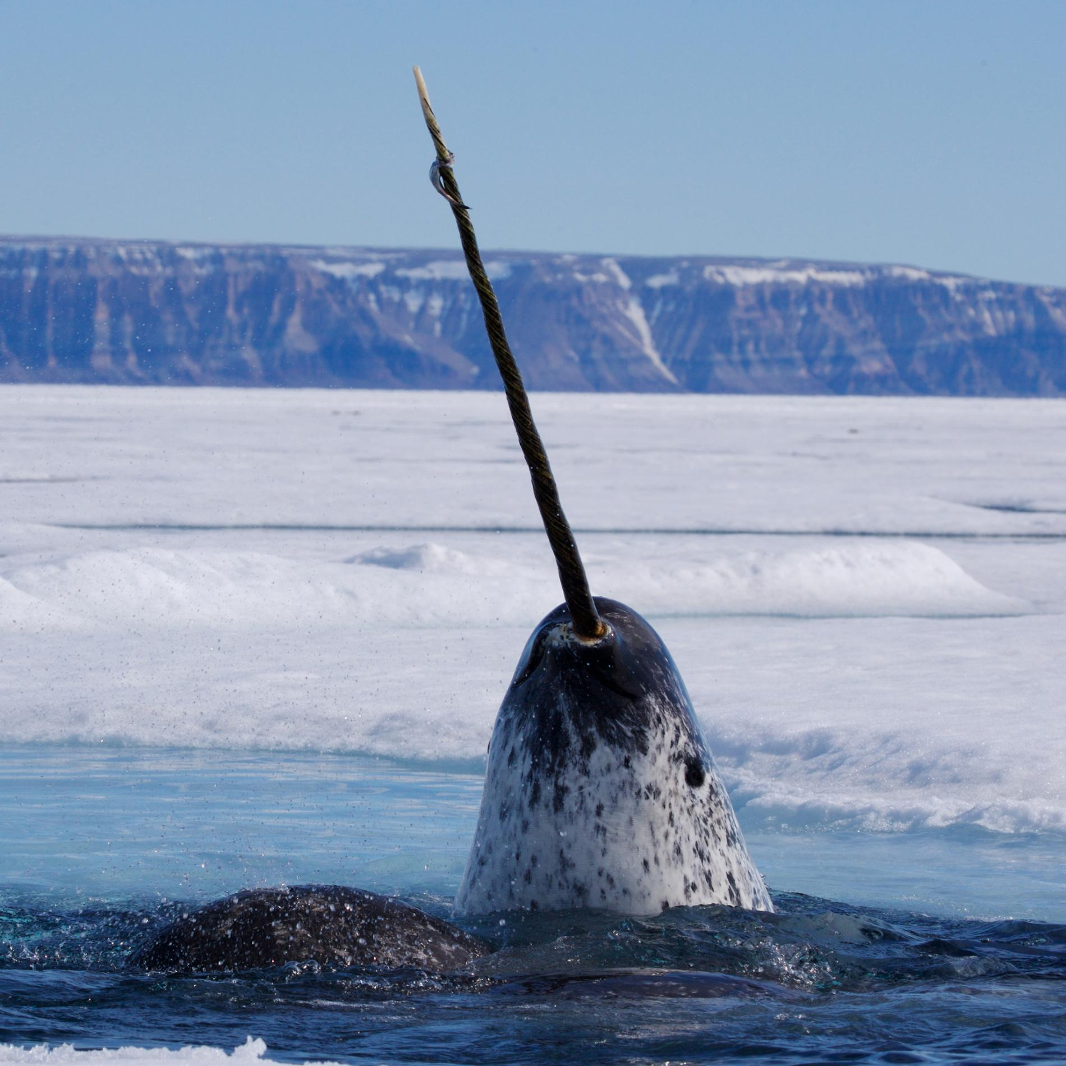
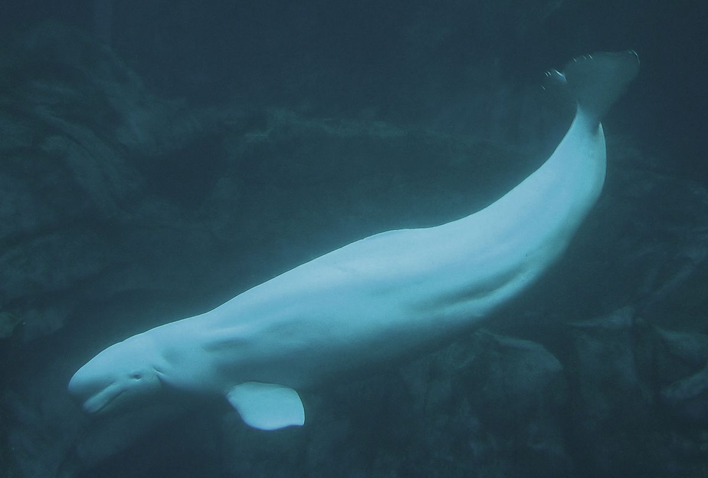
Cetartiodactyla
Odontocetes

Slide 14
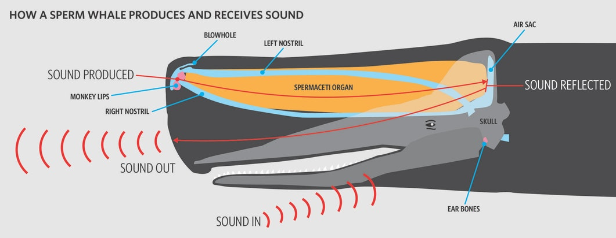
Cetartiodactyla
Odontocetes

Slide 15
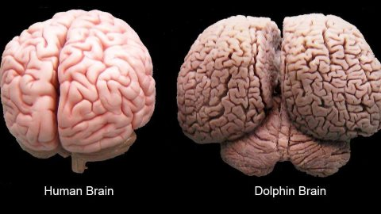
Cetartiodactyla
Odontocetes

Slide 16
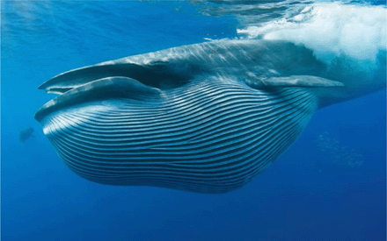
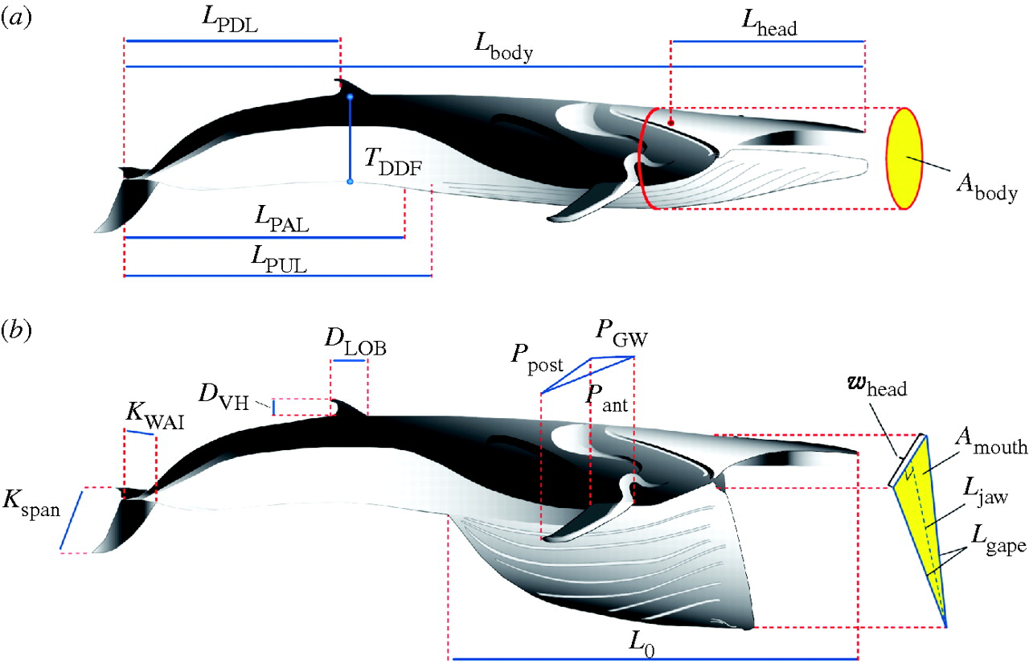
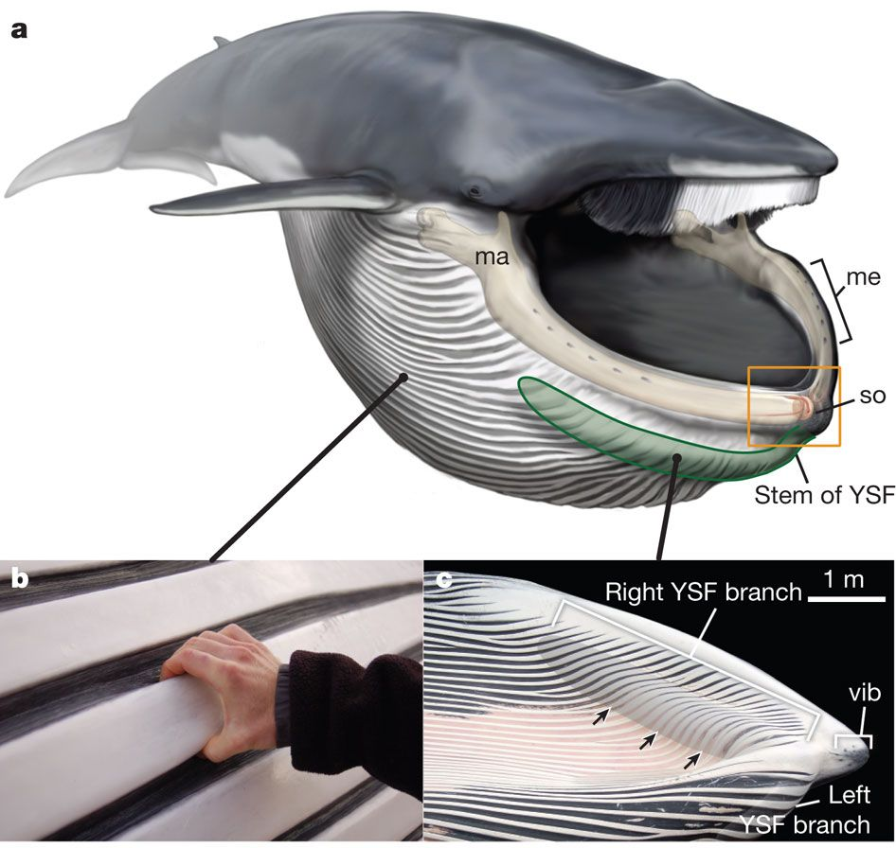
Cetartiodactyla
Mysticetes
Notes:
Here we report the discovery of a sensory organ embedded within the fibrous symphysis between the unfused jaws that is present in several rorqual species, at both fetal and adult stages. Vascular and nervous tissue derived from the ancestral, anterior-most tooth socket insert into this organ, which contains connective tissue and papillae suspended in a gel-like matrix. These papillae show the hallmarks of a mechanoreceptor, containing nerves and encapsulated nerve termini. Histological, anatomical and kinematic evidence indicate that this sensory organ responds to both the dynamic rotation of the jaws during mouth opening and closure, and ventral groove blubber⁷expansion through direct mechanical linkage with the y-shaped fibrocartilage structure. Along with vibrissae on the chin⁹, providing tactile prey sensation, this organ provides the necessary input to the brain for coordinating the initiation, modulation and end stages of engulfment, a paradigm that is consistent with unsteady hydrodynamic models and tag data from lunge-feeding rorquals^{10,11,12,13}.

Slide 17

Cetartiodactyla
Mysticetes

Slide 18



Cetartiodactyla
Artiodactyls – ungulate limbs

Slide 19







Ferae: Perissodactyla
Tapirs (4), rhinos (5), horses (7)

Slide 20

Ferae: Perissodactyla
Artiodactyl
Perissodactyl

Slide 21

Ferae: Perissodactyla

